Slide 2
UML dynamic Modeling (Behavior Diagram)
Objects are created and destroyed, objects send messages to one another in an orderly fashion, and in some system, external events trigger operations on certain objects.
Objects have states.
The state of an object would be difficult to capture in a static model.
In OOD dynamic modeling can be represented by following diagrams
Behavior Diagram
Sequence diagrams
Collaboration diagrams
Statechart Diagram
Activity Diagram

Slide 3
UML Interaction Diagram
It is a diagram that describes how groups of objects collaborate to get the job done.
Interaction diagram capture the behavior of a single use case, showing the pattern of interaction among objects.
The diagram shows a number of example objects and the messages passed between those objects within the use case.
There are two kinds of interaction models: sequence diagrams and collaboration diagrams.

Slide 4
UML Sequence Diagram
The behavior of a system by viewing the interaction between the system and its environment.
A sequence diagram shows an interaction arranged in a time sequence.
It shows the objects participating in the interaction by their life lines and the messages they exchange, arranged in a time sequence.
A sequence diagram has two dimensions: the vertical dimension represents time, the horizontal represents different objects.

Slide 5
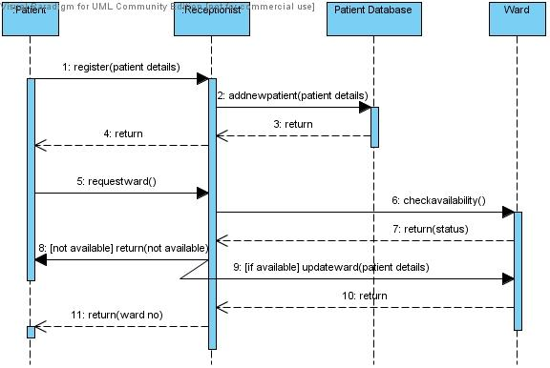
Sequence Diagram for Patient Admit / Registration

Slide 6
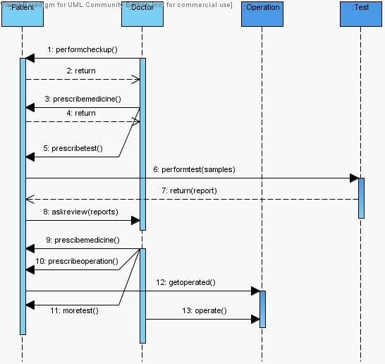
Sequence Diagram Test & Operation:-

Slide 7
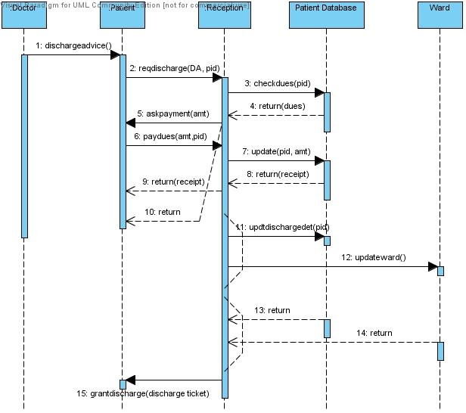
Sequence Diagram Discharge from Hospital

Slide 8
UML Collaboration Diagram
A collaboration diagram represents a collaboration, which is a set of objects related in a particular context, and interaction, which is a set of messages exchanged among the objects within the collaboration to achieve a desired outcome.
In a collaboration the sequence is indicated by numbering the messages.
The collaboration is more compressed, other things can be shown more easily.
It provides several number scheme.

Slide 9
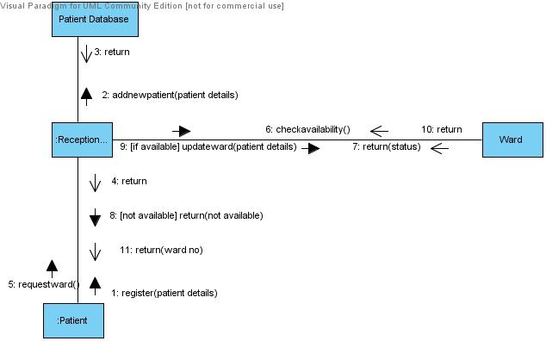
Collaboration Diagram Admit to Hospital

Slide 10
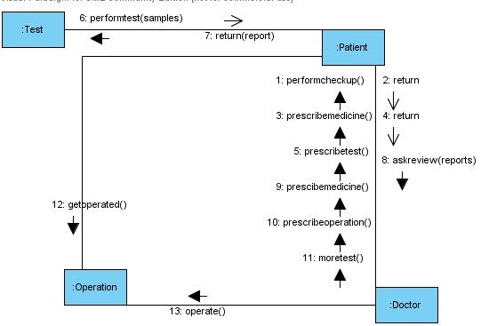
Collaboration Diagram for Treatment at Hospital

Slide 11
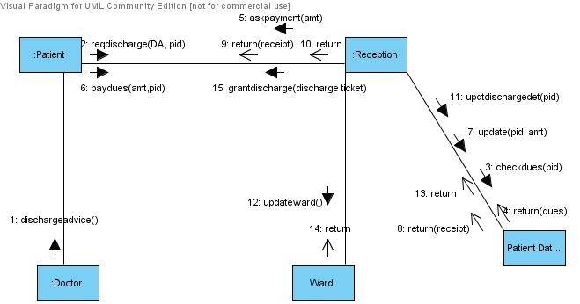
Collaboration Diagram for Discharge from Hospital

Slide 12
UML Statechart Diagram
A Statechart diagram describes a state machine.
Now to clarify it state machine can be defined as a machine which defines different states of an object and these states are controlled by external or internal events.
Statechart diagram is one of the five UML diagrams used to model dynamic nature of a system.
They define different states of an object during its lifetime. And these states are changed by events.
So Statechart diagrams are useful to model reactive systems. Reactive systems can be defined as a system that responds to external or internal events.
Statechart diagram describes the flow of control from one state to another state.
States are defined as a condition in which an object exists and it changes when some event is triggered.
So the most important purpose of Statechart diagram is to model life time of an object from creation to termination.

Slide 13
Following are the main purposes of using Statechart diagrams:
To model dynamic aspect of a system.
To model life time of a reactive system.
To describe different states of an object during its life time.
Define a state machine to model states of an object.

Slide 14
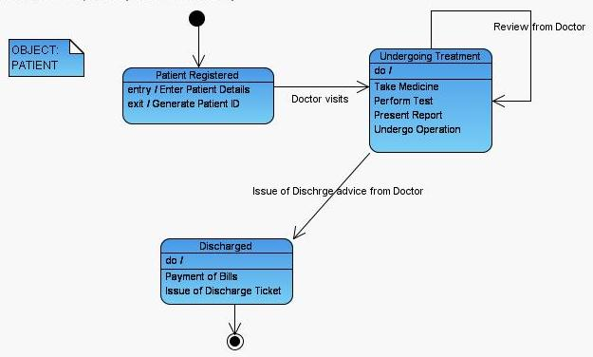
State Chart Diagram for Patient

Slide 15
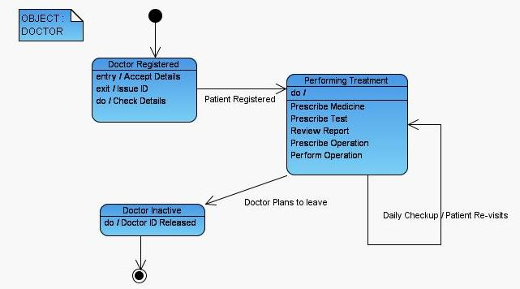
State Diagram for Doctor

Slide 16
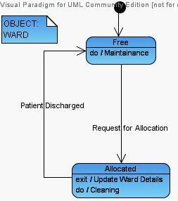
State Diagram for Ward Object

Slide 17
UML Activity Diagram
Activity diagram is basically a flow chart to represent the flow form one activity to another activity. The activity can be described as an operation of the system.
It captures the dynamic behaviour of the system.
activity diagram is used to show message flow from one activity to another.

Slide 18
Activity is a particular operation of the system. Activity diagrams are not only used for visualizing dynamic nature of a system but they are also used to construct the executable system by using forward and reverse engineering techniques.
The only missing thing in activity diagram is the message part.

Slide 19
The purposes can be described as:
Draw the activity flow of a system.
Describe the sequence from one activity to another.
Describe the parallel, branched and concurrent flow of the system.

Slide 20
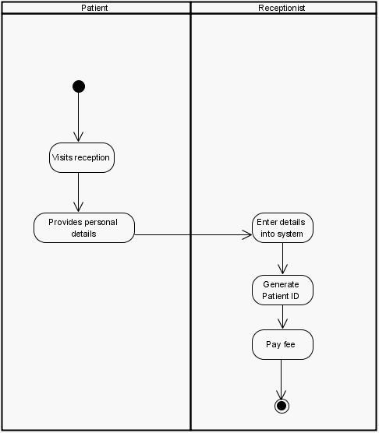
Activity Diagram Registration :-

Slide 21
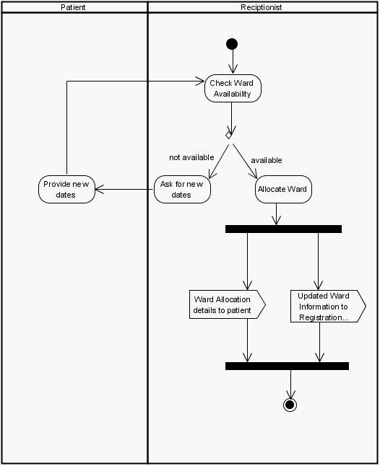
Activity Diagram for Ward Allocation:-

Slide 22
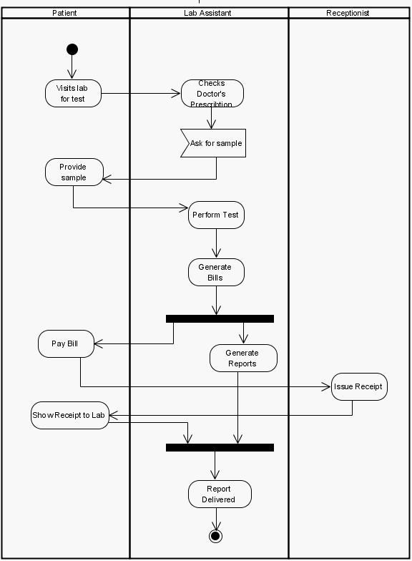
Activity Diagram for Tests to Perform:-

Slide 23
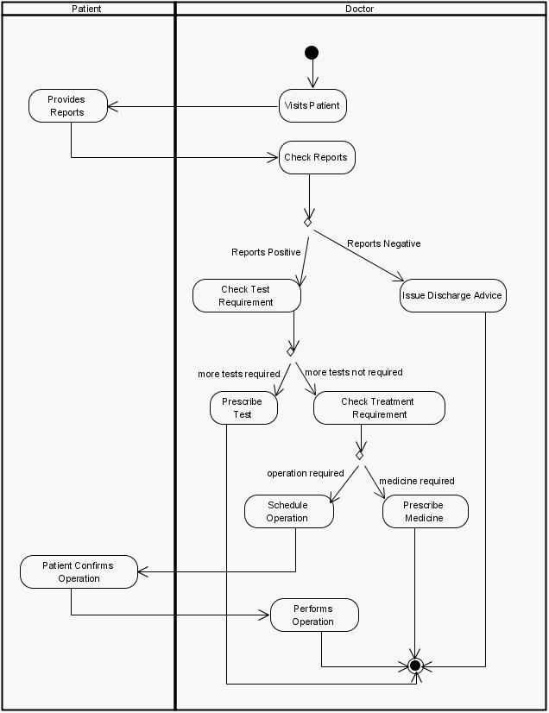
Activity Diagram for Treatment and Operations:-

Slide 24
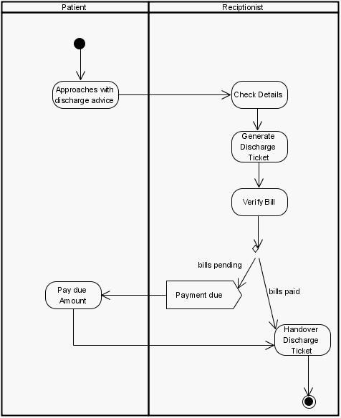
Activity Diagram Discharge:-

Slide 25
Following are the main usages of activity diagram:
Modeling work flow by using activities.
Modeling business requirements.
High level understanding of the system's functionalities.
Investigate business requirements at a later stage.

Slide 26
Implementation Diagram
It shows the implementation phase of systems development, such as the source code structure and the run-time implementation structure.
There are two types of implementation diagrams: component diagrams show the structure of the code itself, and deployment diagrams show the structure of the runtime system

Slide 27
Component diagram
It model the physical components(such as source code, executable program, user interface) in a design.
These high level physical components may or may not be equivalent to the many smaller components you use in the creation of your application.
Another way of looking at components is the concept of packages.
A package is used to show how you can group together classes, which in essence are smaller scale components.
Packages will be covered in the next section, but a point worth mentioning here is that a package usually will be used to group logical components of the application, such as classes, and not necessarily physical components.

Slide 28
However, the package could be a first approximation of what eventually will turn into physical grouping.
In that case, the package will become a component.
A component diagram is a graph of the design’s components connected by dependency relationships.
A component is represented by boxed figure.
Dependency is shown as a dashed arrow.

Slide 29
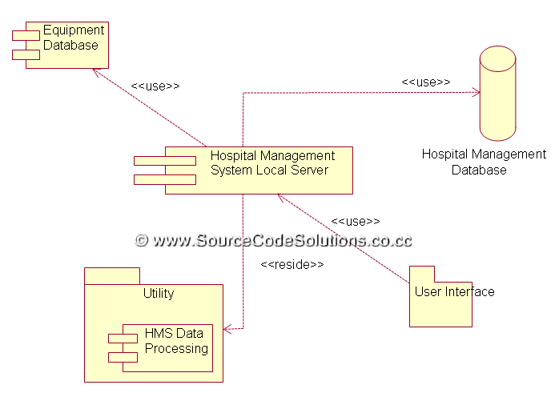
Component diagram

Slide 30
Deployment Diagram
It show the configuration of run-time processing elements and the software components, processes, and objects that live in them.
Software component instances represent run-time manifestations of code units.
In most cases, component diagrams are used in conjunction with deployment diagrams to show how physical modules of code are distributed on various h/w platform
In many cases, component and deployment can be combined.

Slide 31
A deployment diagram is a graph of nodes connected by communication association.
Nodes may contain component instances, which means that the component lives or runs at that node.
Components are connected to other components by dashed-arrow dependencies, usually through interfaces, which indicate one component uses the services of another.
Each node or processing element in the system is represented by a three-dimensional box.
Connections between the nodes themselves are shown by solid lines.

Slide 32
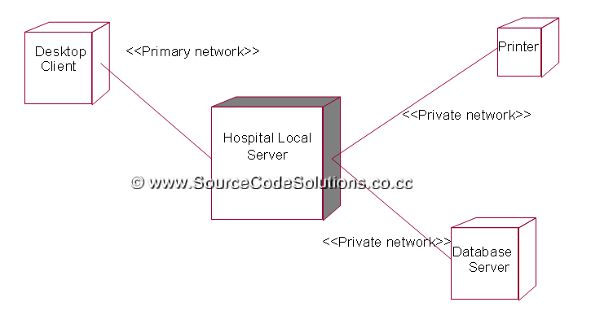
Deployment Diagram

Slide 33
Package Diagram
A package is a grouping of model elements.
Packages themselves may contain other packages.
Package may contain both subordinate packages and ordinary model elements.
The entire system can be thought of as a single high-level package with everything else in it.
All UML model elements and diagrams can be organized into packages.
A package is represented as a folder, shown as a large rectangle with a tab attached to its upper left corner.
If contents of the package are shown, then the name of the package may be placed on the tab.
The contents of the package are shown within large rectangle.

Slide 34
